Slide 1
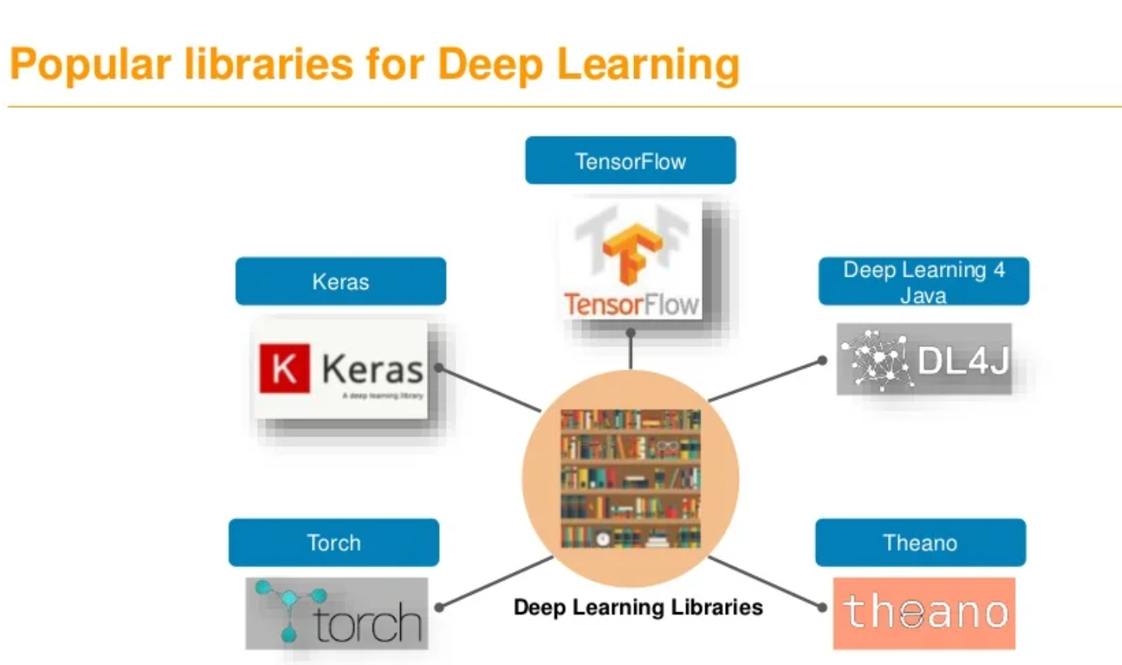
Notes:
A deep learning framework is an interface, library or a tool which allows us to build deep learning models more easily and quickly, without getting into the details of underlying algorithms. They provide a clear and concise way for defining models using a collection of pre-built and optimized components.
A library performs specific, well-defined operations. A framework is a skeleton where the application defines the "meat" of the operation by filling out the skeleton.
When you use a library, you are in charge of the flow of the application. You are choosing when and where to call the library. When you use a framework, the framework is in charge of the flow

Slide 2
Why use Deep Learning Frameworks?
Optimized for performance
Easy to understand and code
Good community support
Parallelize the processes to reduce computations
Automatically compute gradients
Deep learning frameworks offer building blocks for designing, training and validating deep neural networks, through a high level programming interface.
Notes:
Instead of writing hundreds of lines of code, we can use a suitable framework to help us to build such a model quickly.

Slide 3
What is Tensorflow?
TensorFlow is an open source software library for numerical computation using dataflow graphs. Nodes in the graph represents mathematical operations, while graph edges represent multi-dimensional data arrays (aka tensors) communicated between them. The flexible architecture allows you to deploy computation to one or more CPUs or GPUs in a desktop, server, or mobile device with a single API.
Open source library for numerical computation using data flow graphs
Developed by Google Brain Team to conduct machine learning research.Based on DisBelief used internally at Google since 2011.
“TensorFlow is an interface for expressing machine learning algorithms, and an implementation for executing such algorithms”

Slide 4
A major difference between Numpy and TensorFlow is that TensorFlow follows a lazy programming paradigm. It first builds a graph of all the operation to be done, and then when a “session” is called, it “runs” the graph. It’s built to be scalable, by changing internal data representation to tensors (aka multi-dimensional arrays). Building a computational graph can be considered as the main ingredient of TensorFlow.
You can build other machine learning algorithms on it such as decision trees or k-Nearest Neighbors. You can literally do everything you normally would do in Numpy! It’s aptly called “Numpy on steroids”

Slide 5
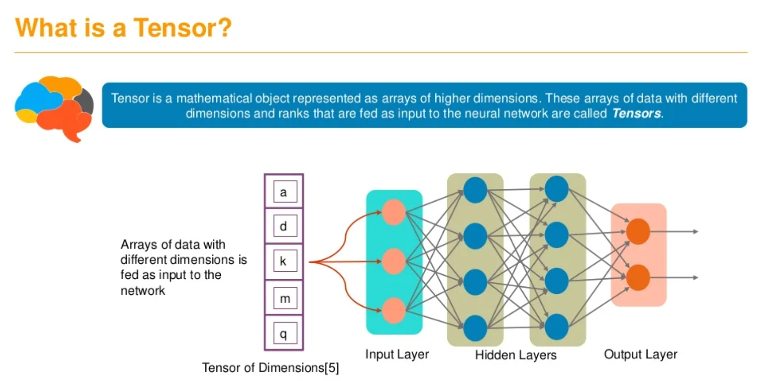

Slide 6
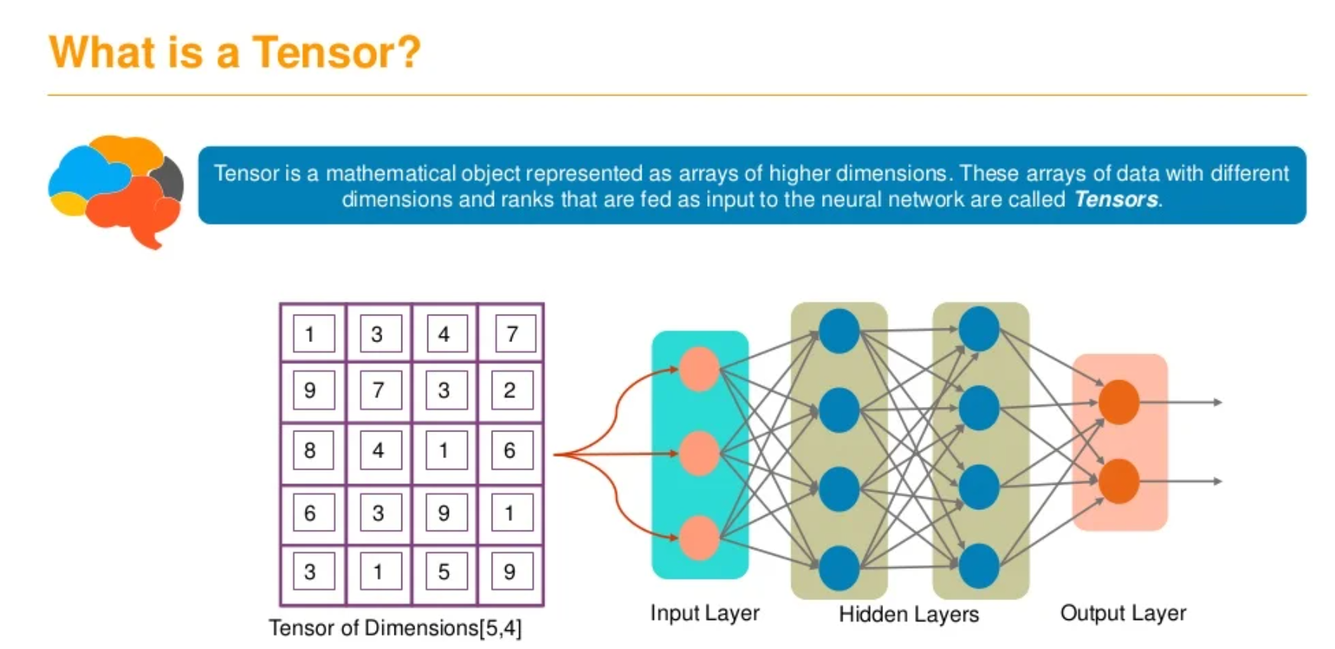

Slide 7
Numpy arrays vs Tensors
A NumPy array is a grid of values belonging to the same numerical type. This homogeneity allows mathematical operations to be more efficient and reduces memory usage in data storage in contrast to other data structures like python lists and pandas data frames. An array can be one-dimensional or multi-dimensional. We can think of a multi-dimensional array as a container of arrays of the same type and size.
A TensorFlow tensor is actually an array on steroids sharing most of the array’s functionalities and more. Much like arrays, tensors can be one-dimensional and multi-dimensional or have 0 to n axis as we can more accurately define. More specifically, a tensor with zero axis contains only a single value and is called a “scalar”, a tensor with one axis contains a list of values and is called a “vector”, a tensor with 2 axes is called a “matrix” etc. In the case of multi-dimensional tensors, each item must be of the same size just like arrays

Slide 8
Cont…
The main selling point of tensors is, since being part of the TensorFlow library, using GPU accelerated computing. Simply put, without any change in code, TensorFlow allows you to parallelize tensor calculations across the cores of a GPU greatly improving speed against its NumPy array counterpart. There are still ways to reap the benefits of the beloved GPU computing with arrays but are not supported natively with the NumPy library.
Functionalities like GPU computing and automatic differentiation make tensors ideal data structures to handle the complexity of deep learning models, whether you prefer TensorFlow or PyTorch as your go-to framework.
In any other case, NumPy arrays will be your everyday driver due to their ease of use and setup. Generally speaking, one can consider NumPy arrays as an optimized version of python lists. So apart from using them as the input data format to machine learning models, they should also be your go-to structure for any type of scientific computing with Python.

Slide 9
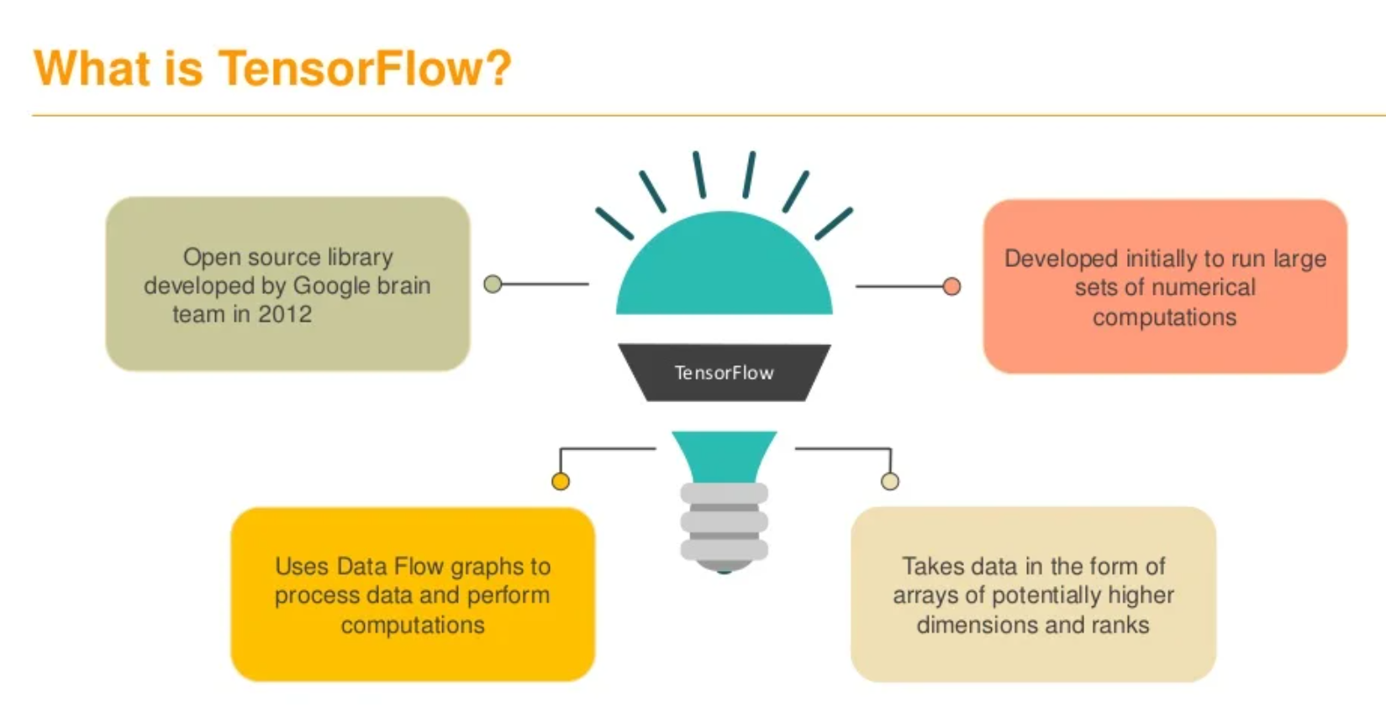

Slide 10
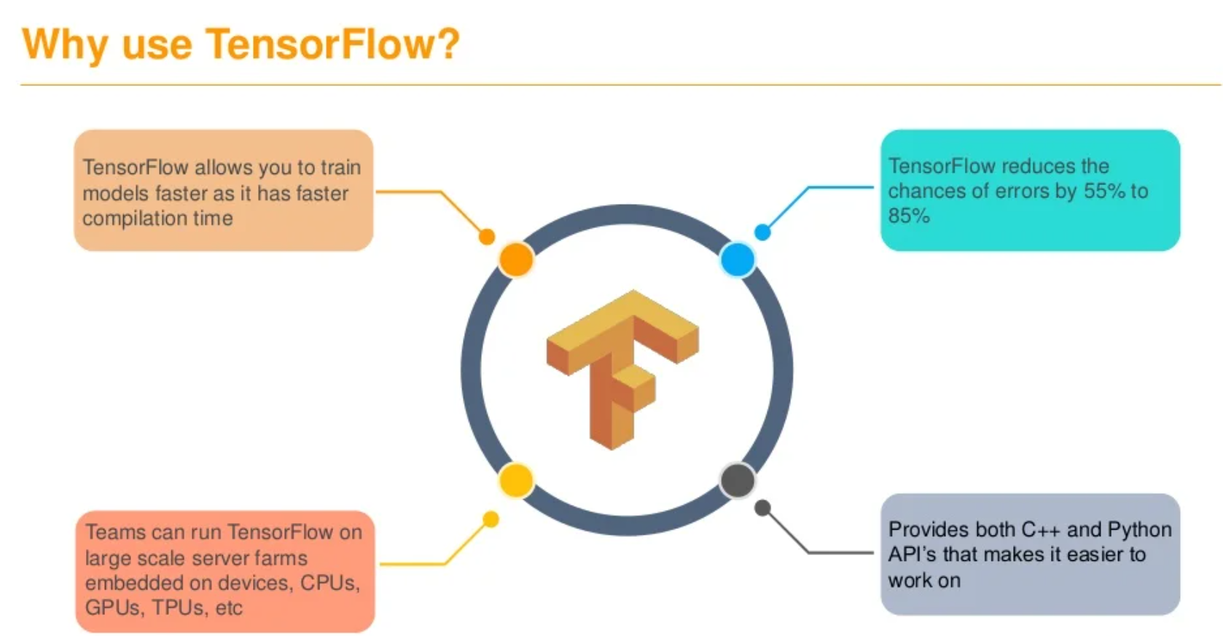

Slide 11
Key Points..
TensorFlow is an open source software library for numerical computation using dataflow graphs
Nodes in the graph represents mathematical operations, while graph edges represent multi-dimensional data arrays (aka tensors) communicated between them.
“TensorFlow is an interface for expressing machine learning algorithms, and an implementation for executing such algorithms”.
“Numpy on steroids”.
More specifically, a tensor with zero axis contains only a single value and is called a “Scalar”, a tensor with one axis contains a list of values and is called a “Vector”, a tensor with 2 axes is called a “Matrix” etc.,

Slide 12
Cont..
It has an intuitive construct, because as the name suggests it has “flow of tensors”. You can easily visualize each and every part of the graph.
Platform flexibility. You can run the models wherever you want, whether it is on mobile, server or PC.
Python is the most convenient client language for working with TensorFlow. However, there are also experimental interfaces available in JavaScript, C ++, Java and Go, C # and Julia.
TF takes into account not only powerful computing clusters but also the ability to run models on mobile platforms like iOS and Android.
TF operates with a static computation graph. That is, we first define the graph, then we run the calculations and, if we need to make changes to the architecture, we re-train the model. Such an approach was chosen for the sake of efficiency, but many modern neural network tools are able to take into account refinements in the learning process without a significant loss in learning speed. In this regard, the main competitor of TensorFlow is the PyTorch.

Slide 13
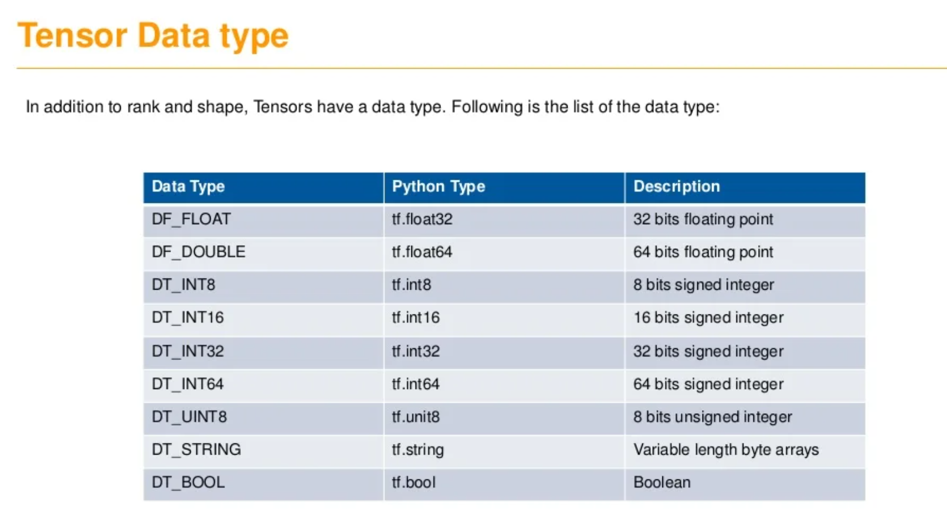

Slide 14
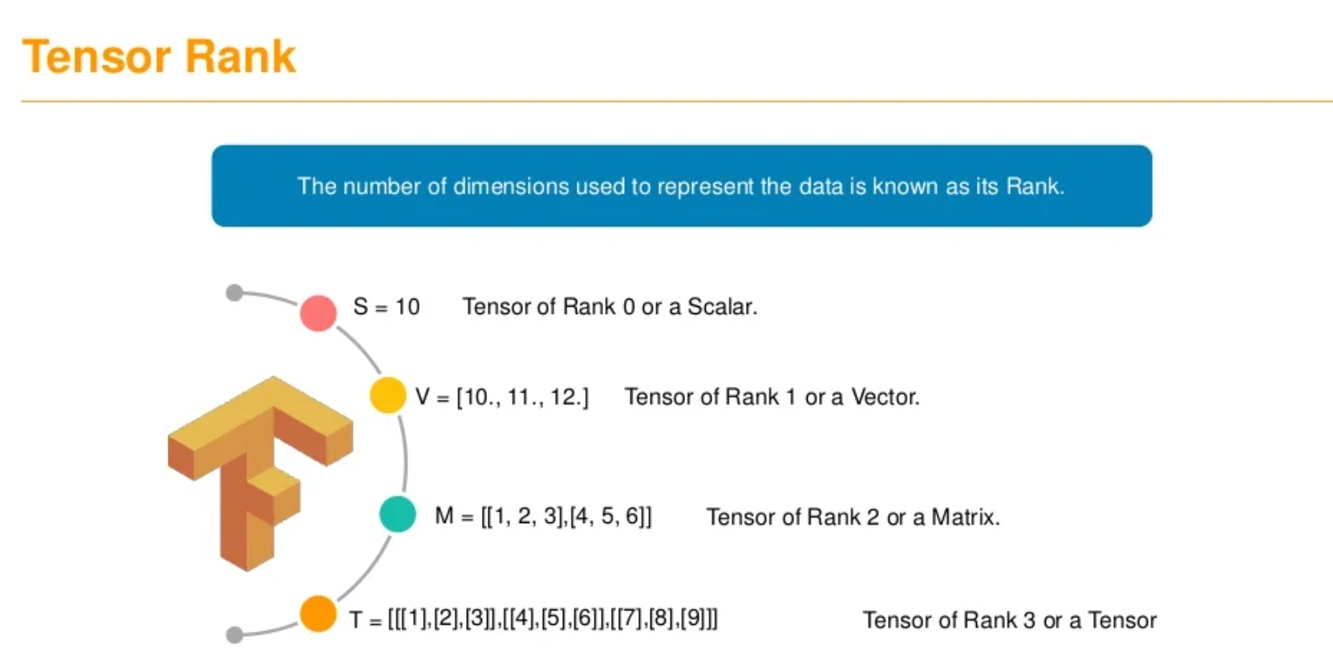

Slide 15
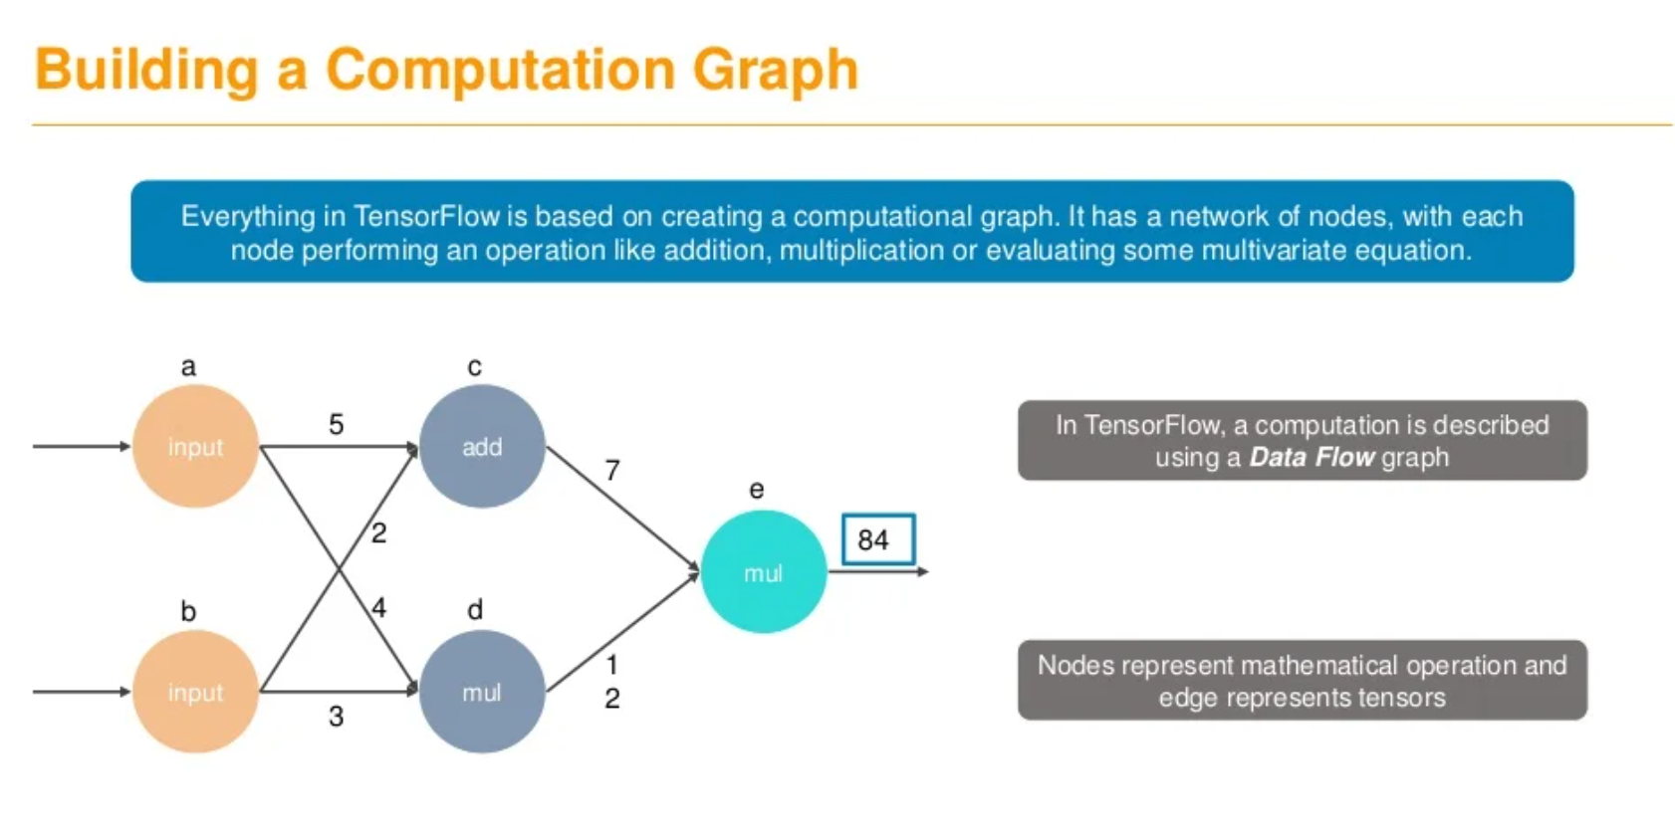

Slide 16
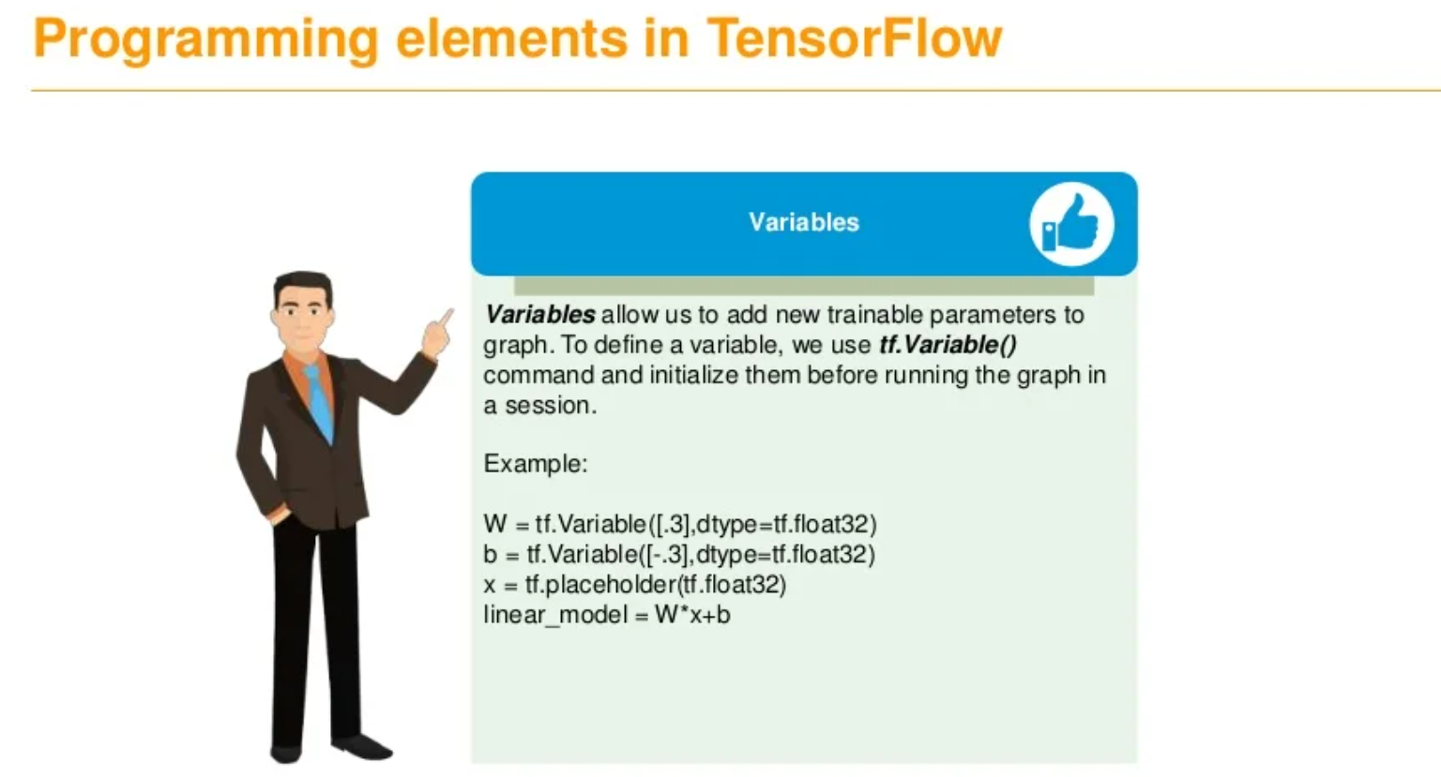

Slide 17
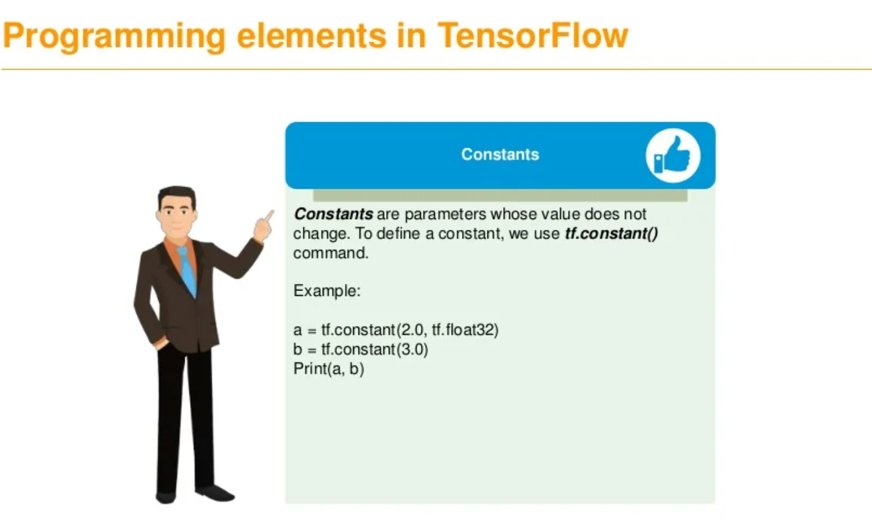

Slide 18
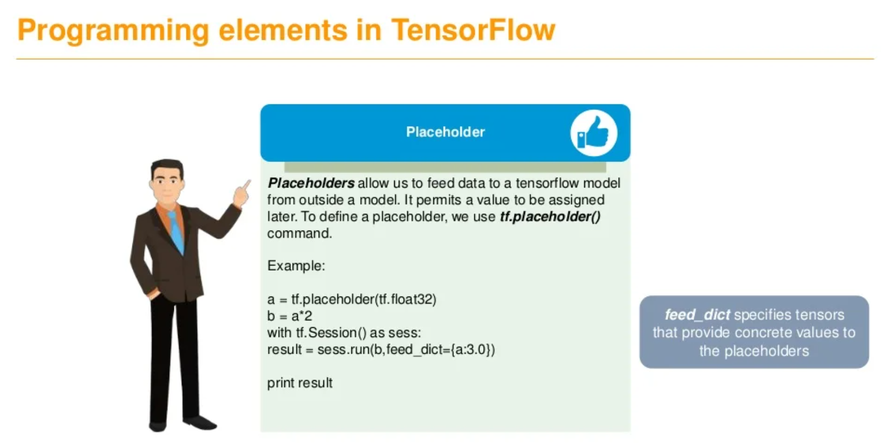

Slide 19
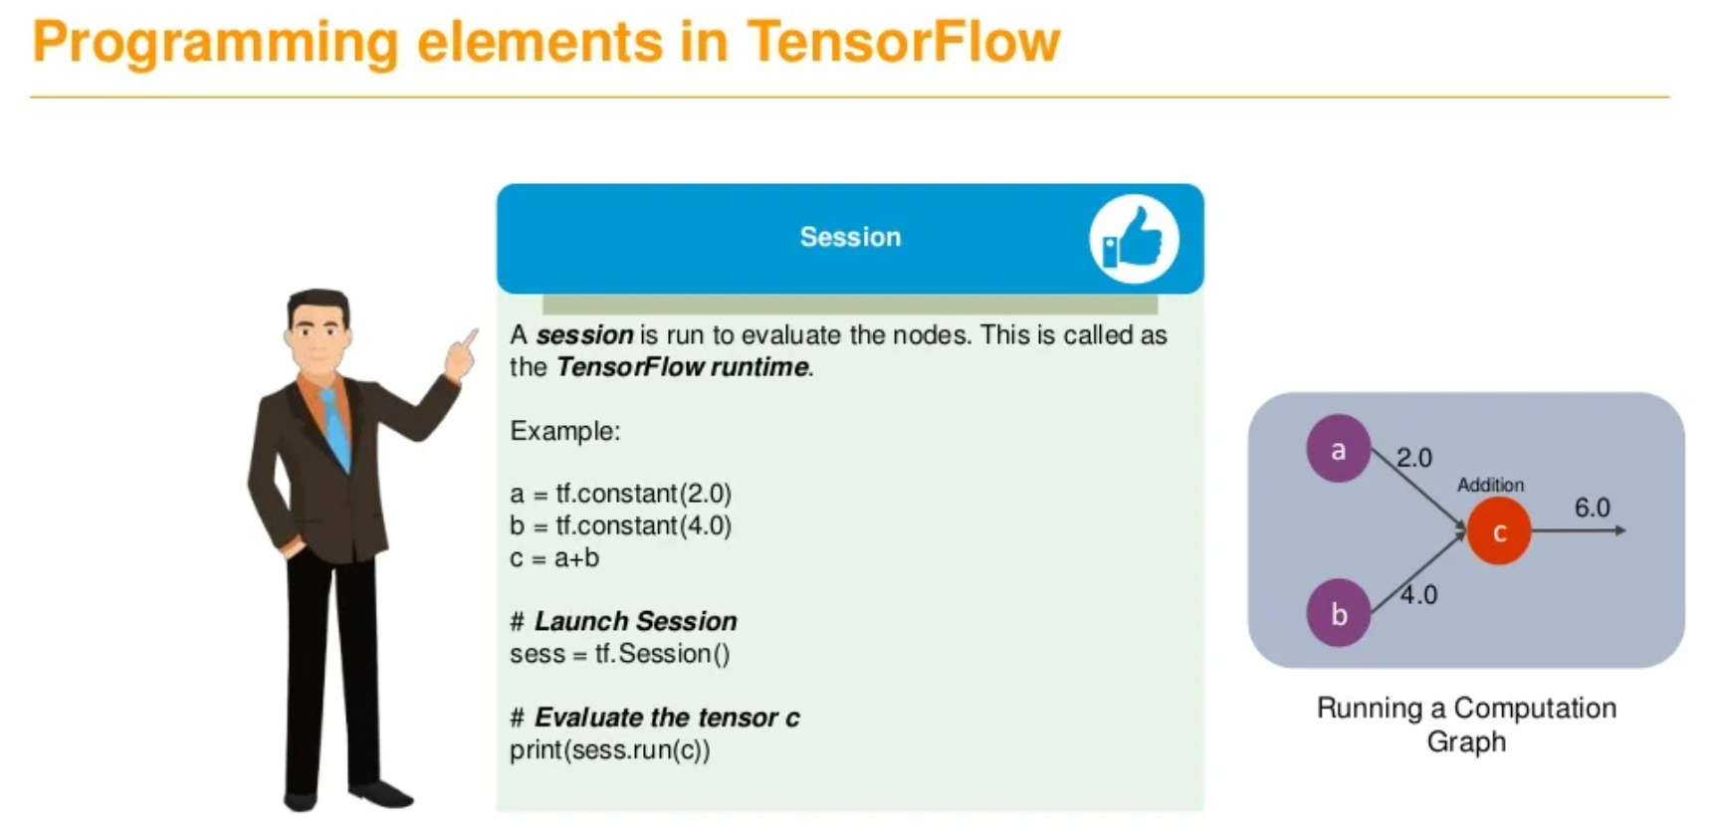

Slide 20
Usual Workflow..
Build a computational graph, this can be any mathematical operation TensorFlow supports.
Initialize variables, to compile the variables defined previously
Create session, this is where the magic starts!
Run graph in session, the compiled graph is passed to the session, which starts its execution.
Close session, shutdown the session.

Slide 21
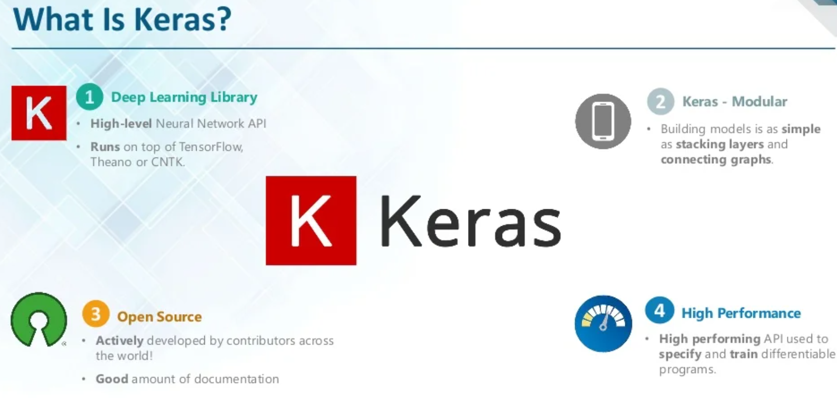
Notes:
Keras is an open-source neural-network library written in Python. It is capable of running on top of TensorFlow, Microsoft Cognitive Toolkit, Theano, or PlaidML. Designed to enable fast experimentation with deep neural networks, it focuses on being user-friendly, modular, and extensible

Slide 22
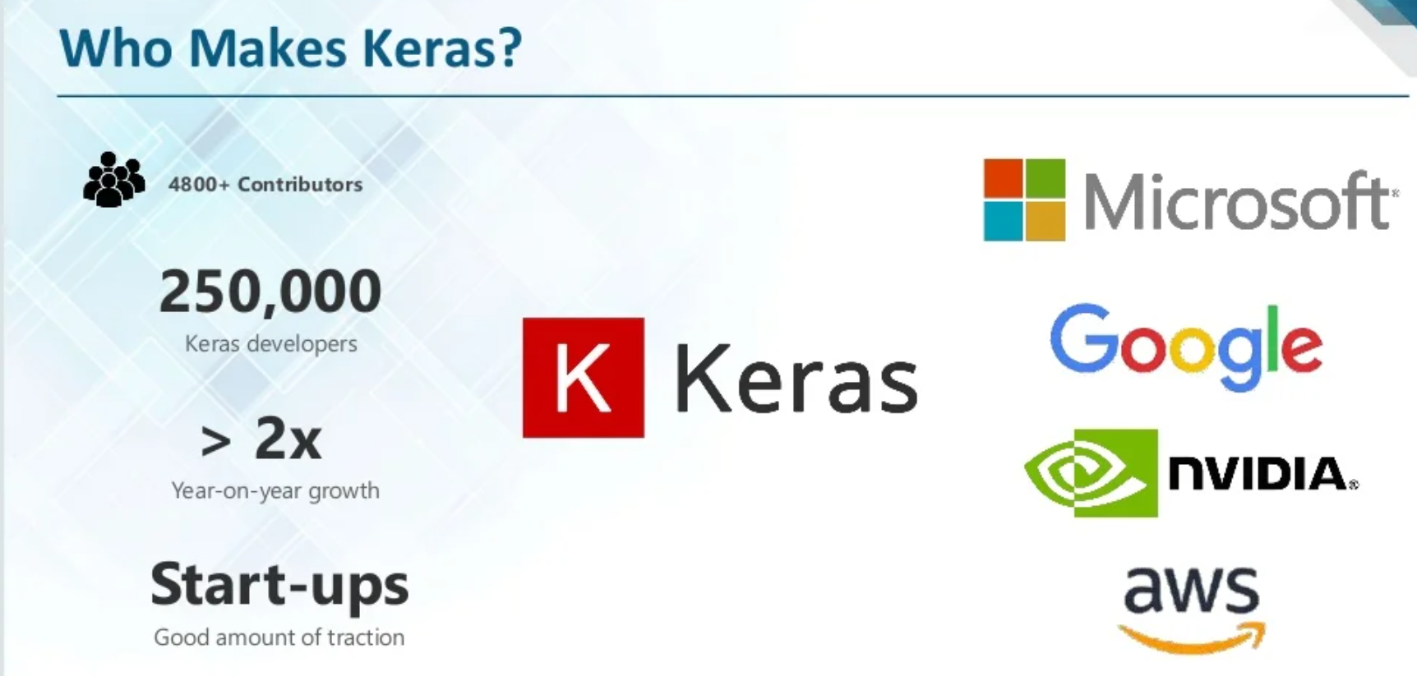

Slide 23
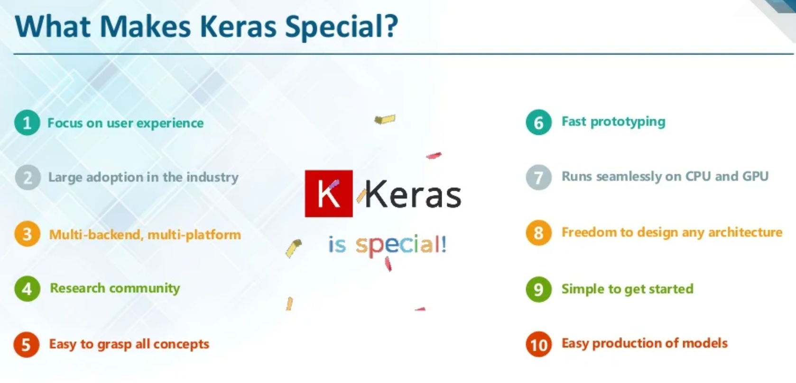

Slide 24
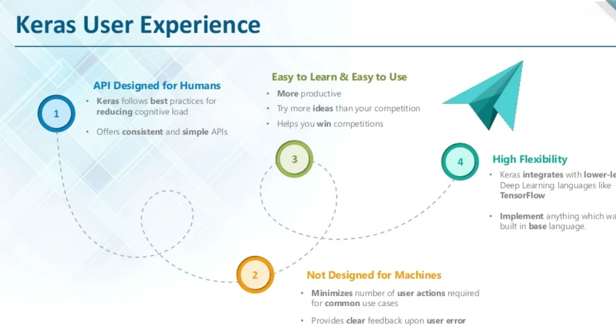

Slide 25
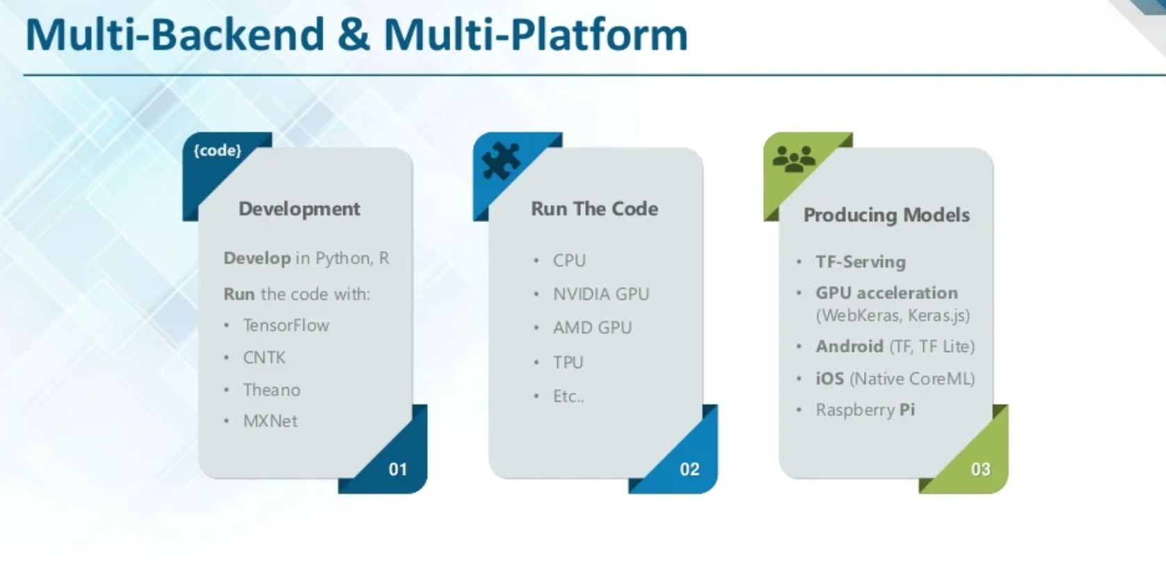

Slide 26
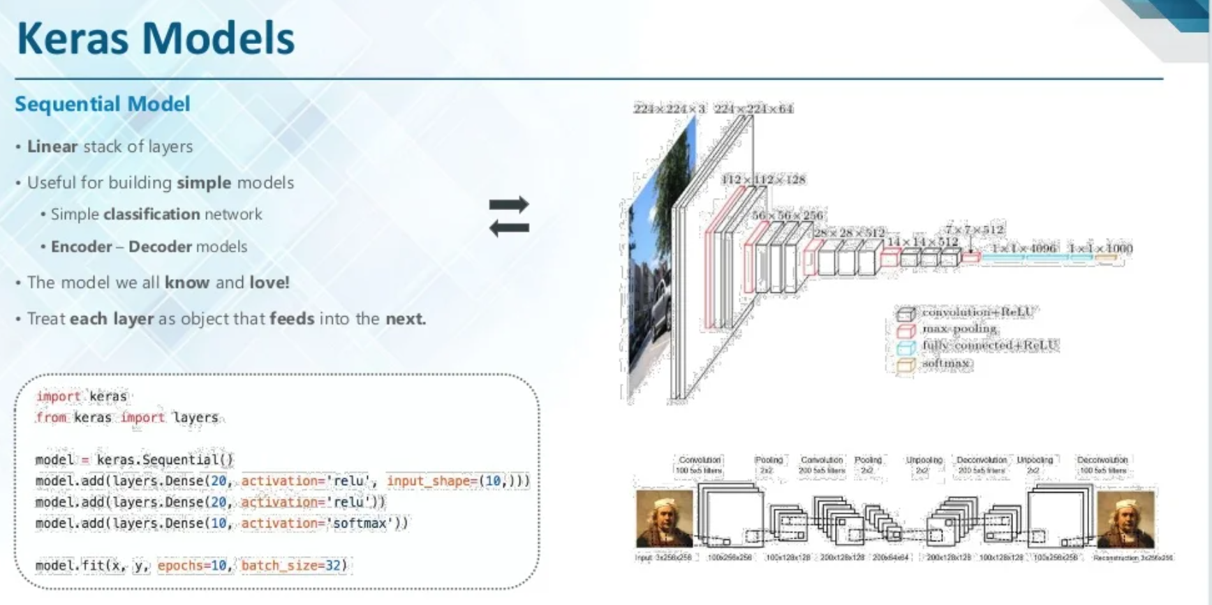
Notes:
We can broadly classify models in Keras into two categories:
1)Sequential: The layers of the model are defined in a sequential manner. This means that when we’re training our deep learning model, these layers are implemented sequentially.
2) Keras functional API: This is generally used for defining complex models, such as multi-output models or models with shared layers.

Slide 27
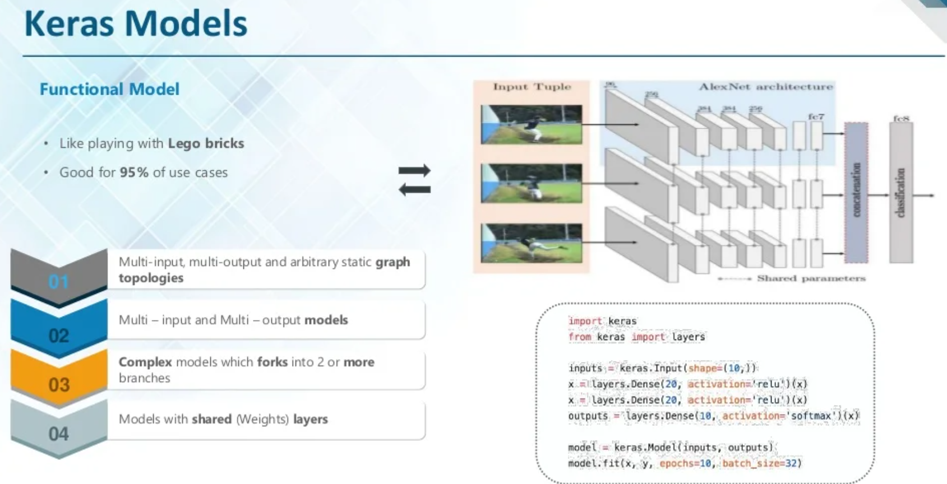

Slide 28
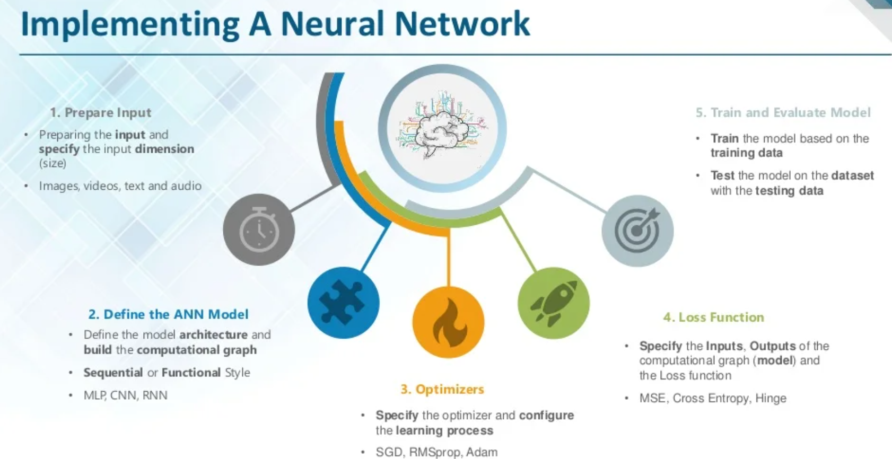
Notes:
Activation functions are computational functions for neuron computation and interaction. They are functions that engages each neuron cell in active learning of patterns between input data and its corresponding target data.
loss functions are mathematical algorithms that helps measure how close a neural net learns to getting the actual result.
Optimizers are Classes or methods used to change the attributes of your machine/deep learning model such as weights and learning rate in order to reduce the losses. Optimizers help to get results faster.
In simple sentences, an optimizer can basically be referred to as an algorithm that helps another algorithm to reach its peak performance without delay. With respect to machine learning (neural network), we can say an optimizer is a mathematical algorithm that helps our loss function reach its convergence point with minimum delay (and most importantly, reduce the posibility of gradient explosion). Examples include, adam, stochastic gradient descent (SGD), adadelta, rmsprop, adamax, adagrad, nadam etc.
To change the parameters the optimizer’s role came in, which ties the model parameters with the loss function by updating the model in response to the loss function output. Simply optimizers shape the model into its most accurate form by playing with model weights. The loss function just tells the optimizer when it’s moving in the right or wrong direction.

